Slide 1
Docker Fundamentals
Padmanabha Venkatagiri Seshadri
Research Scientist
IBM Research
Notes:
OM NAMO GANAPATHAYEN NAMAHA

Slide 2
Introduction
As we have already learnt,
Containers are an abstraction of capabilities supported and provided by the Linux Kernel
Containers are hard to start-up through user-programs.
Tools like LXC which pre-dated Docker simplified creation to some extent, but mnt name space and network management remained cumbersome. This gave rise to docker.
Docker is a platform which facilitates packaging and management of distributed applications in containers which have
Low over-head in terms of resources consumed.
Encapsulate all system/context dependencies of the component(s) of the application.
Portable enough to be moved around from one host to another.

Slide 3
Installing Docker
For this tutorial, already installed on the VMs
Currently supported on Linux (CentOS, Debian, Fedora, Ubuntu), macOS, Windows 10.
For more information on installation, visit https://docs.docker.com/install/

Slide 4
Architecture

Slide 5
Big Picture
Docker Daemon: Provides services to the client through RESTful API and json objects. Orchestrates sub-systems.
Docker Client: Provides CLI which in-turn connects to Docker Daemon through RESTful API.
Execution Driver: Manages container life-cycle (start, stop, destroy). Creates the namespaces and control groups, security controls and network for the container. Native execdriver packaged as libcontainer which has subsequently evolved into runC.
Storage Driver: Manages local docker image cache, assembly/disassembly of container file-system.
Local Repositories: Local cache of docker images pulled from a registry or created locally on the host.
Registries: Provide repositories for management of storage and distribution of docker images.
Registries
Docker Client (Eg. CLI)
Docker Daemon
Execution Driver
Docker Remote API
Storage Driver
Containers
Local Repositories

Slide 6
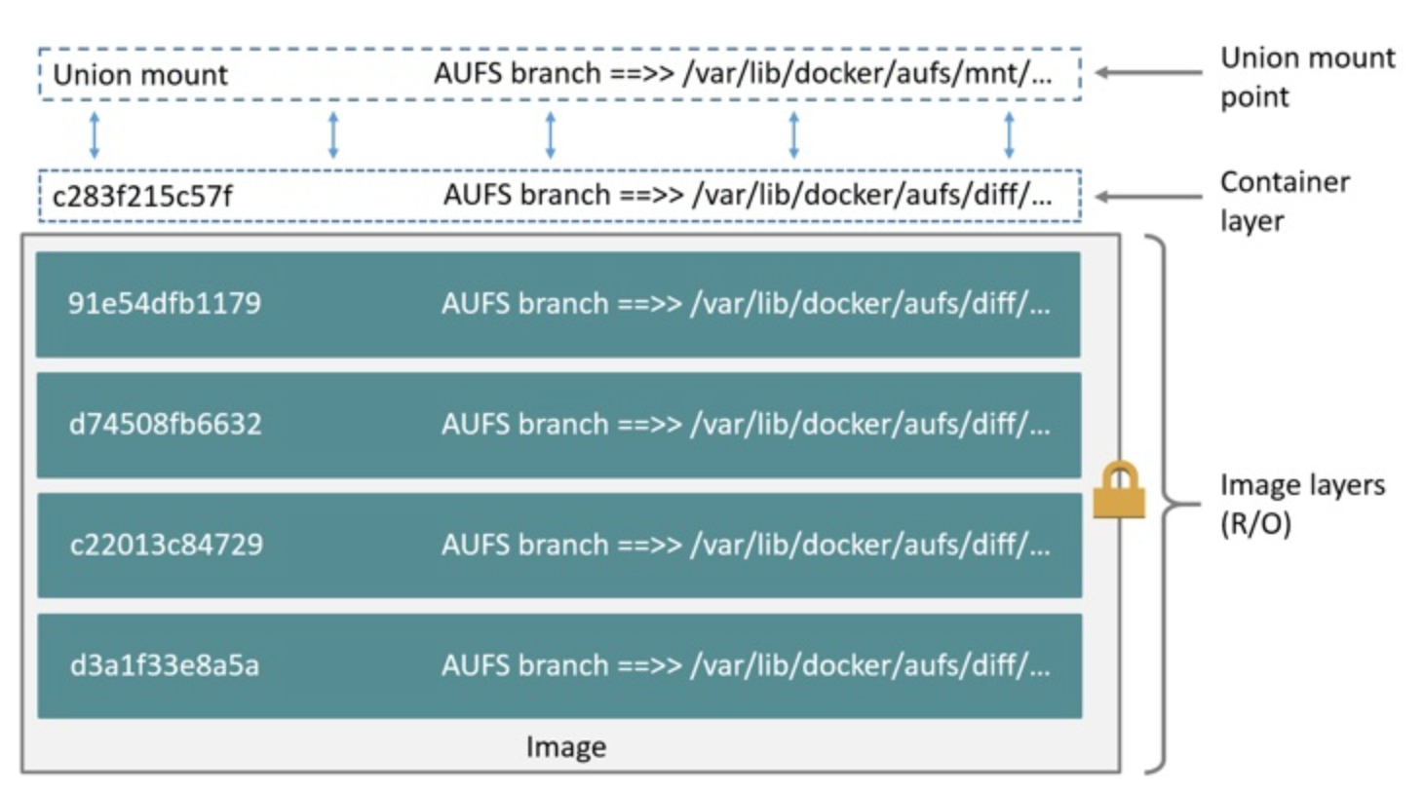
Docker Image And Layers
Docker image is a template which is used to initiate the container.
The image is constituted by several layers, which are combined to create a container.
Except for a “base image”, every layer in the image has a parent.
Images as identified by 256-bit ID which is depicted as a 64-bit ID by docker CLI.
Usually the docker base images are supplied by the DockerHub, but they could also be proprietary.
Illustration of ubuntu:latest image. There is a container layer and several read-only layers. The union of these layers form the final ubuntu image.
Source: https://docs.docker.com/storage/storagedriver/aufs-driver/

Slide 7
Container File-System And Copy-On-Write
The storage driver that assembles the file-system for the container using the images adds two additional layers.
Init layer which contains the mount points to inject runtime files into the container’s filesystem. This layer is read-only.
Container’s read-write layer which facilitates the container to modify or create files.
Copy-on-write feature that allows for sharing of read-only layers of the images so as to reduce their storage foot-print. Whenever, a file in a read-only layer needs to be changed, a copy of it is made in the read-write layer and modifications are applied. The editable copy ”overrides” its counter-part in the lower layer.

Slide 8
More On The Storage Driver
Multiple choices for storage driver exist. The choice depends on:
User Vs Daemon specified
How much kernel support exists for the storage driver features
How much compatibility exists with respect to the file system
How well it performs
Storage driver | Characteristics
aufs | Union of layers on top of the regular file-system.
btrfs | B-tree file system which supports CoW.
devicemapper | Uses device mapper framework to support CoW.
zfs | CoW as a loadable kernel module.
overlay | Similar to aufs.

Slide 9
Docker Registries & Image Names
Registries manage repositories for docker image storage and distribution
Both public and private registries are available. DockerHub [https://hub.docker.com/] is the default registry.
Docker Images are named uniquely using a Fully Qualified Image Name (FQIN) as below:
<Registry Location>/<Namespace>/<Repository Name>:<TAG>
docker.io/library/ubuntu:latest

Slide 10
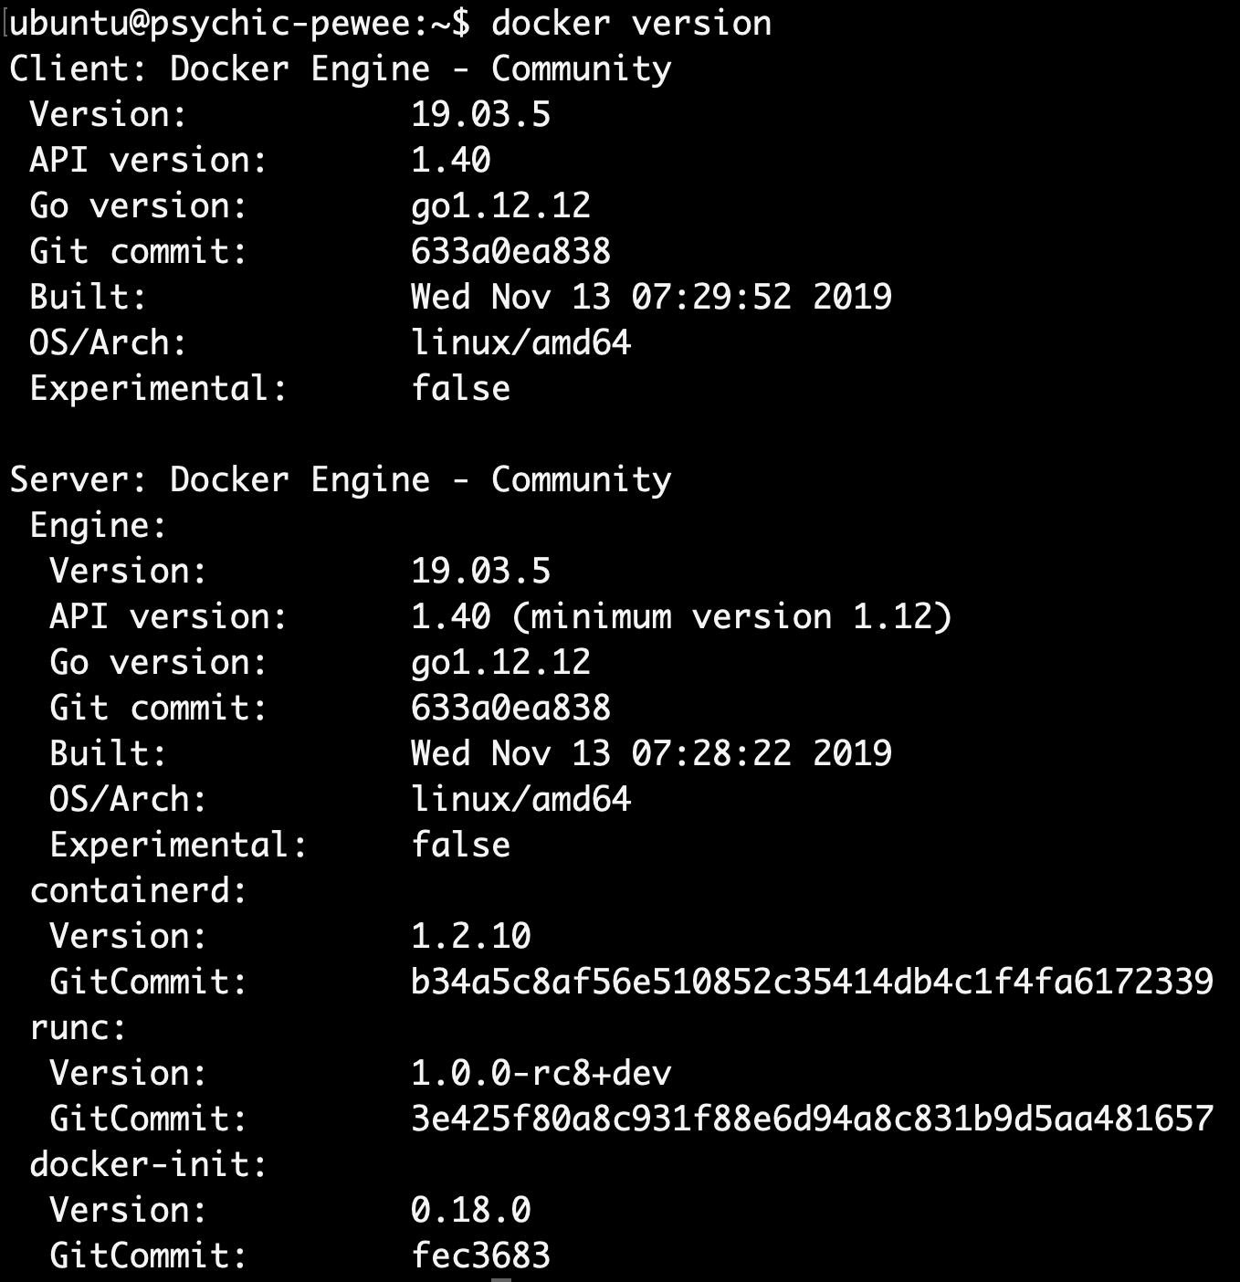
Docker Client
Lists out configuration details
> docker version
Lists out versioning and build details

Slide 11
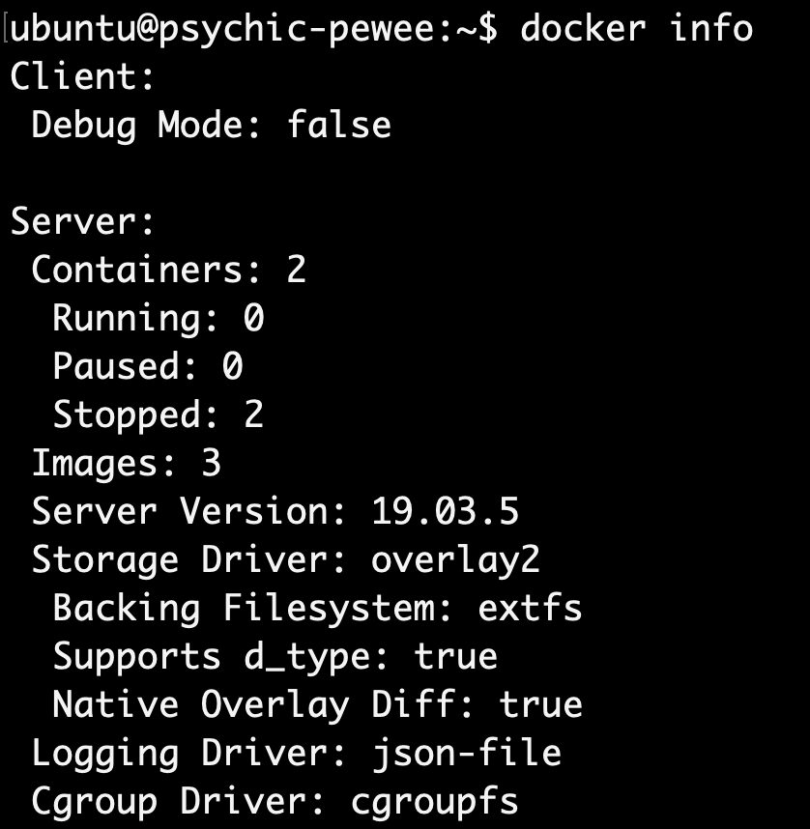
Docker Client
> docker info
Partial output shown. Lists out configuration details

Slide 12
Container Life-Cycle

Slide 13

States
Exited
Docker Hub
> docker stop/kill
> docker start
> docker pull
Created
Started
Dead
> docker create
> docker start
> docker run
> docker pause
> docker unpause
Paused

Slide 14
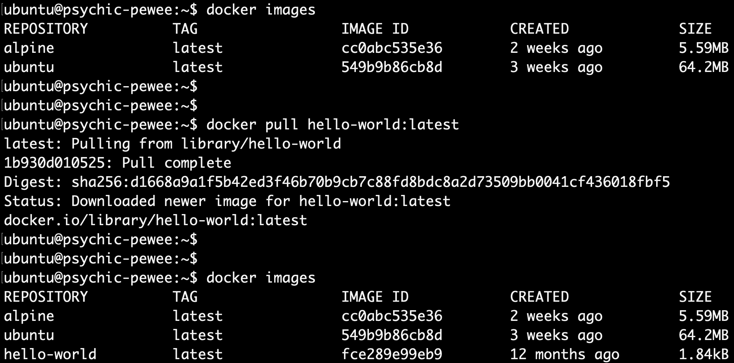
> docker pull
Pull the helloworld-latest image from DockerHub default registry

Slide 15
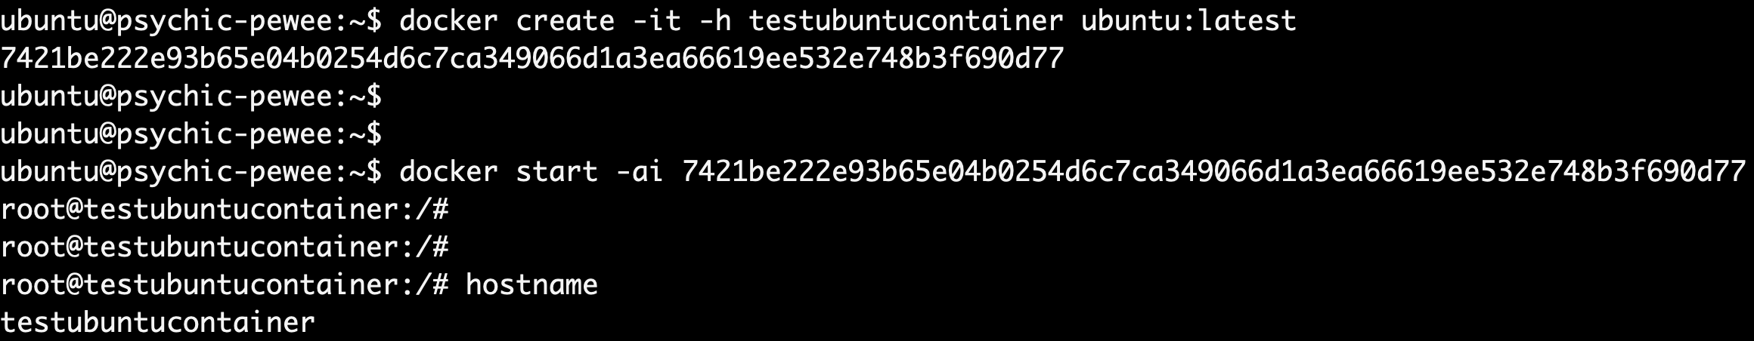
> docker create-start/run
Create-Start: Creates a container with ubuntu image, sets the hostname and start the container separately
Run: Creates and starts the container in one-shot. Note the hostname (configured using –hostname option) displayed below

Slide 16
> docker run
If the docker image is not available, docker run communicates with docker daemon (which in turn communicates with registry and storage driver) to fetch the image from the registry, stores it into the local cache. If it is already available in the local cache, the available image is used.
The daemon then instructs the execution driver to start-up the container with the parameters passed in the docker run command-line.
Registries
Docker Client (Eg. CLI)
Docker Daemon
Execution Driver
Docker Remote API
Storage Driver
Containers
Local Repositories

Slide 17
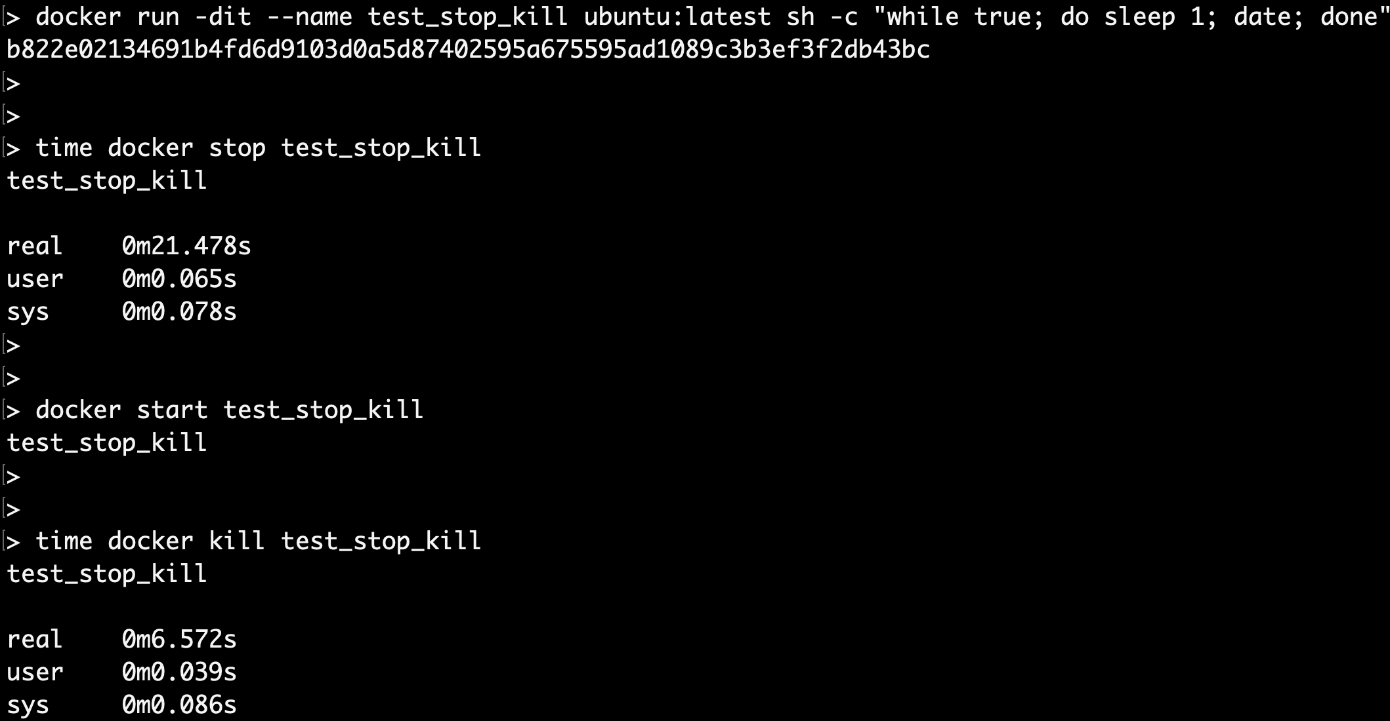
> docker stop/kill
Stop: Graceful (Note the grace period given for the container to cleanup
Kill: Much faster

Slide 18
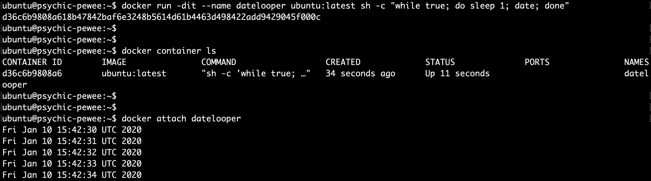
> docker attach
Create and run a container in detached mode. The test script here loops forever and prints date every second.
List the containers to check if the container is active
Attach to container so that the test message echoed to stdout could be seen.

Slide 19
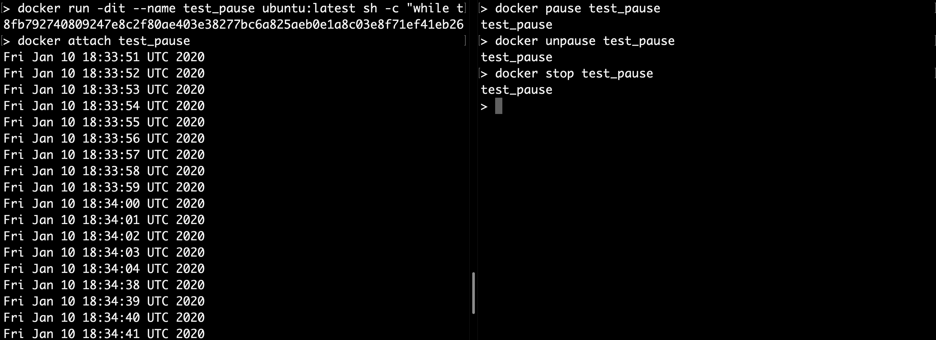
> docker pause/unpause
Pause and unpause moments differ by 34 seconds during which the container remained paused.

Slide 20
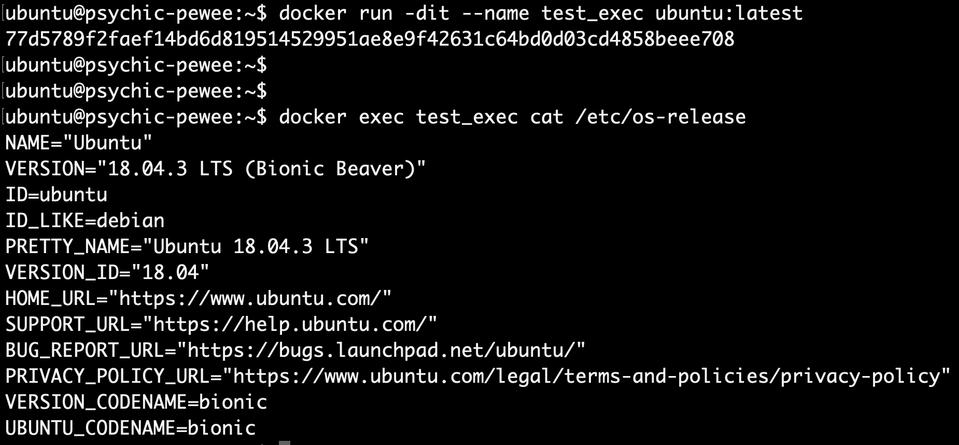
> docker exec
Exec helps in running commands within a container. Above example illustrates the cat /etc/os-release command being run inside the container.

Slide 21
Docker Images: Creation And Management

Slide 22
Dockerfile
The Dockerfile is a file which a user could define using a set of pre-specified instructions so that the docker daemon could execute these instructions on a temporary container and commit the changes indicated by the instructions so as to create an image the user requires.
In the illustration shown, the dockerfile instructions are explained below:
FROM is the first instruction and specifies the base image over which rest of the image is layered.
RUN executes a command within the container. In the illustration, it is used twice. First to update the package repository and second to create a directory.
WORKDIR sets the working directory.
ENV can be used to pass environment variables to the container.
VOLUME indicates that the directory created previously should persist across container runs.
COPY is used to copy files (e.g. test.sh) into the image.
CMD provides default execution parameters for containers. It could be overridden if required during docker run.
#!/bin/bash
echo "This is a start-up script for the app”
echo $TEST_ENV_DATA >> /persisData/datelog.txt
while true; do sleep 1; date | tee –a /persisData/datelog.txt; done
Sample test shell script which prints few messages (one hard-coded and other from env variable) to stdout and appends it to a file, and loops on infinitely printing the date and time, and also appending it to a file.
FROM ubuntu:latest
RUN apt-get update
RUN mkdir /persistData
WORKDIR /app
ENV TEST_ENV_VAR=“This is a winter school demo”
VOLUME /persistData
COPY test.sh /app/test.sh
CMD [”/app/test.sh”]
Sample Dockerfile which uses a ubuntu:latest base image, injects the shell script from above as a layer and sets it as the startup script.
Notes:
SET THE PERMISSIONS: chmod 777 test.sh

Slide 23
> docker build
Sending build context to Docker daemon 4.096kB
Step 1/8 : FROM ubuntu:latest
---> 549b9b86cb8d
Step 2/8 : RUN apt-get update
---> Running in 498b8696e8e7
Fetched 17.4 MB in 18s (966 kB/s)
Reading package lists...
Removing intermediate container 498b8696e8e7
---> 0673a4f5d86d
Step 3/8 : RUN mkdir /persistData
---> Running in 4743b31ed4e4
Removing intermediate container 4743b31ed4e4
---> 662489850574
Step 4/8 : WORKDIR /app
---> Running in 518adf4db352
Removing intermediate container 518adf4db352
---> 1c7327e56d7d
Step 5/8 : ENV TEST_ENV_VAR="This is a winter school demo"
---> Running in d819ecdd4dce
Removing intermediate container d819ecdd4dce
---> ac928bd95928
Step 6/8 : VOLUME /persistData
---> Running in 46cc716c5122
Removing intermediate container 46cc716c5122
---> bb3f49d2f073
Step 7/8 : COPY test.sh /app/test.sh
---> f71ae32d9fd1
Step 8/8 : CMD ["/app/test.sh"]
---> Running in 99a73b2b2907
Removing intermediate container 99a73b2b2907
---> 144d787d605b
Successfully built 144d787d605b
Successfully tagged test:latest
In the snapshot the docker build command used is:
> docker build . –t test:latest
In this illustration (abridged output), the above command is executed within the ~/winter_school folder which contains the DockerFile and the test.sh.
The command accepts the docker file as input and a image-tag (-t) which is the name of the image (test) and the corresponding tag (latest).

Slide 24
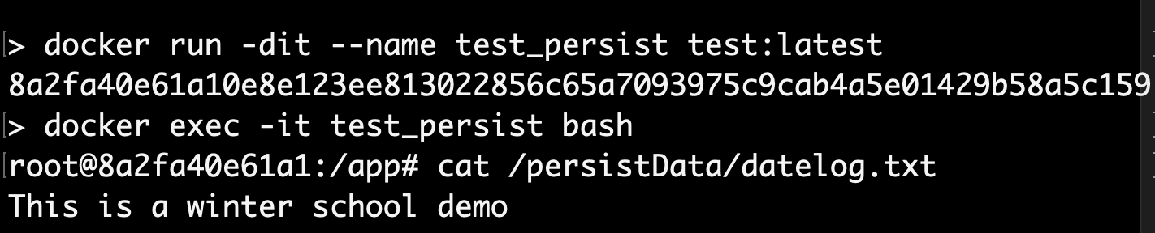
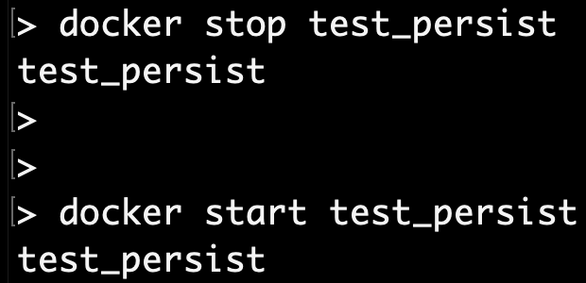
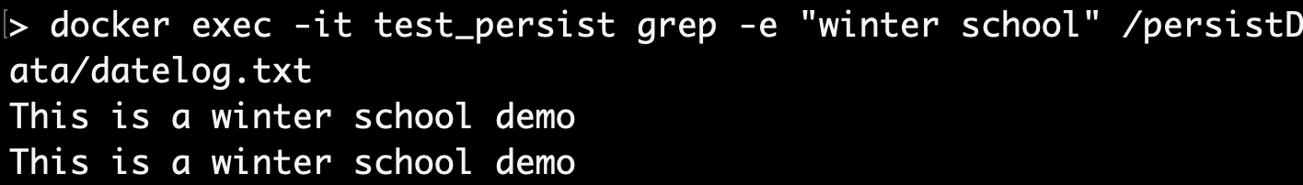
Volume Persistence
Start-up msg written to a file “datelog.txt” in persistent volume “/persistData”
Stop and start the container to check if the start-up msg persists across container runs.
Now, there are two start-up messages logged indicating that the file persisted across container runs.

Slide 25
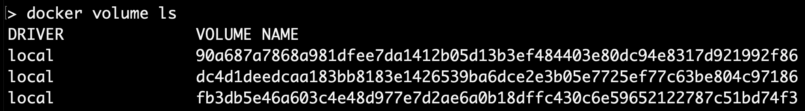
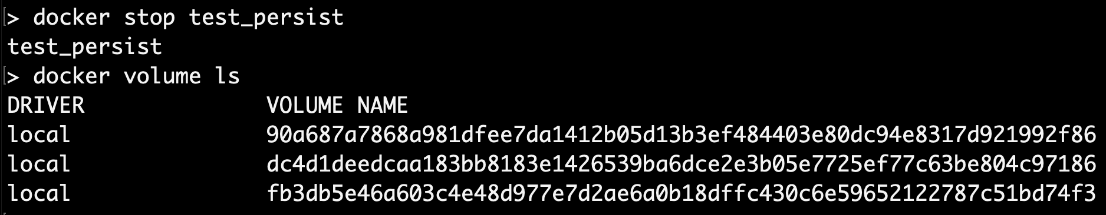
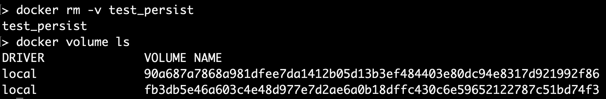
> docker rm
Volume created for test_persist container
Does not go away even after > docker stop
> docker rm Removes the container along with any volume definitions. This is useful to cleanup stale volumes.

Slide 26
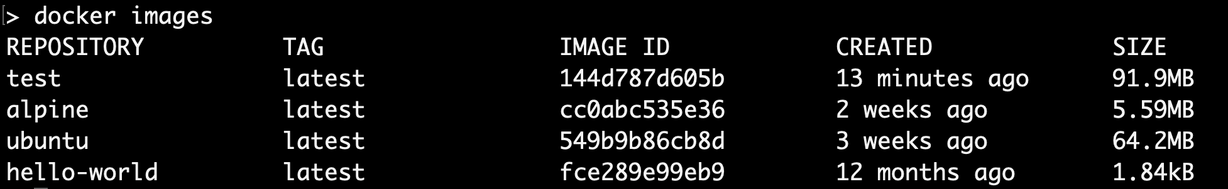
> docker images
Lists all the images (also includes the image created in the previous step) available in the local cache

Slide 27
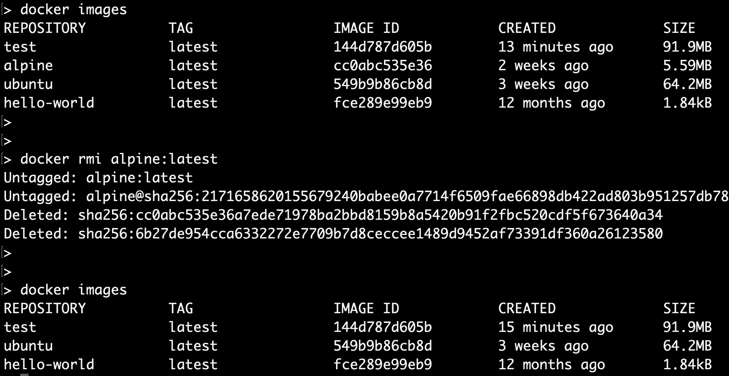
> docker rmi
Removes the image from the local repository cache

Slide 28
Utilities

Slide 29
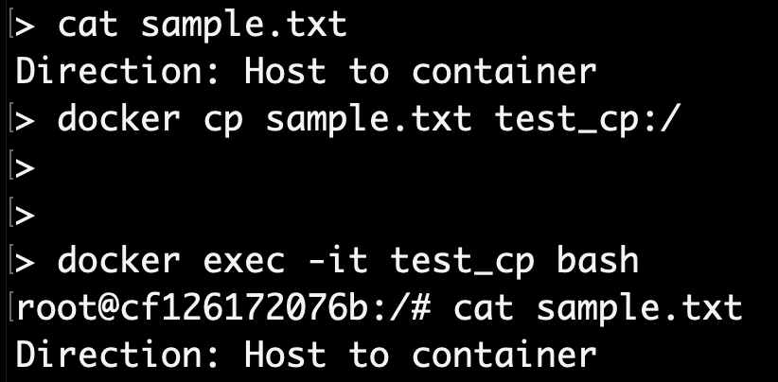
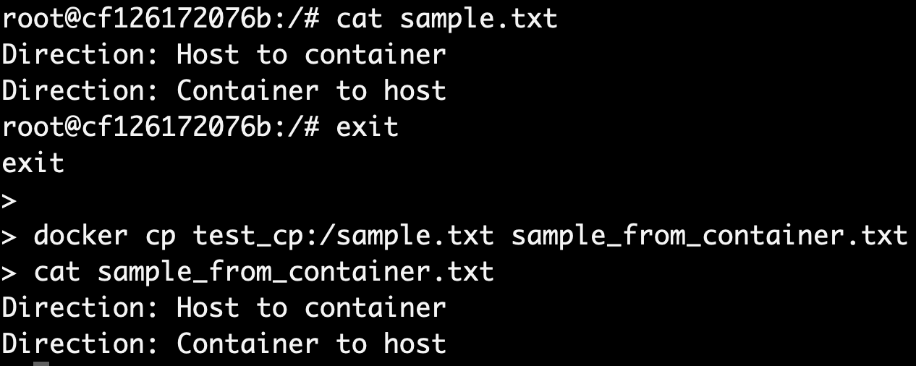
> docker cp
Host to container file copy
Facilitates copying files to and from containers.
Container to host file copy

Slide 30
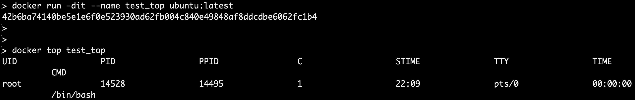
> docker top
Displays processes running within a container. Below example illustrates the bash shell process active within a plain-vanilla ubuntu container.

Slide 31
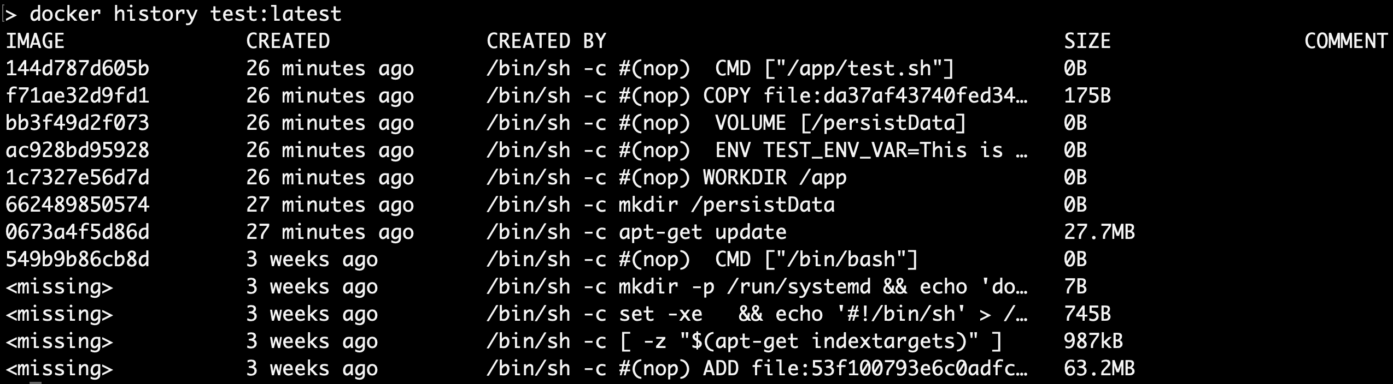
> docker history
FROM ubuntu:latest
RUN apt-get update
RUN mkdir /persistData
WORKDIR /app
ENV TEST_ENV_VAR=“This is a winter school demo”
VOLUME /persistData
COPY test.sh /app/test.sh
CMD [”/app/test.sh”]
Displays information on how an image was created. Below illustrates the image layers for test:latest image created by our sample Dockerfile previously (shown right).
Our layer
Ubuntu layer

Slide 32
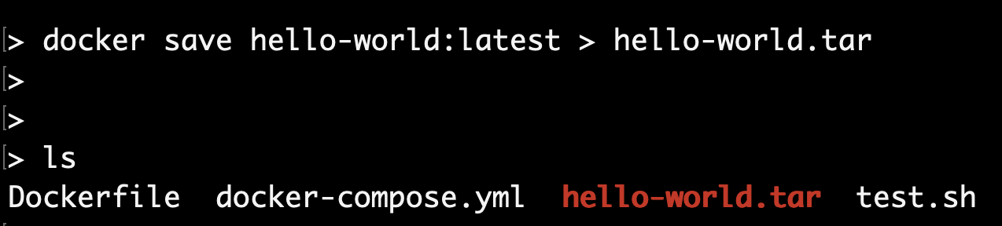
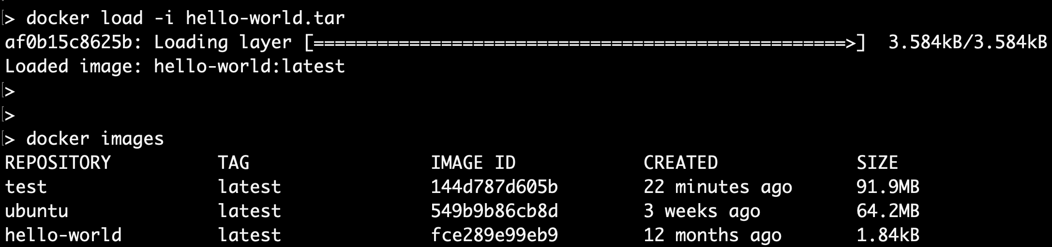
> docker load/save
Save docker image (in this case hello-world:latest) as a tar archive.
Remove the image using docker rmi hello-world:latest.
Load docker image (in this case hello-world:latest) from the tar archive.
Displayed image list shows the loaded image.

Slide 33
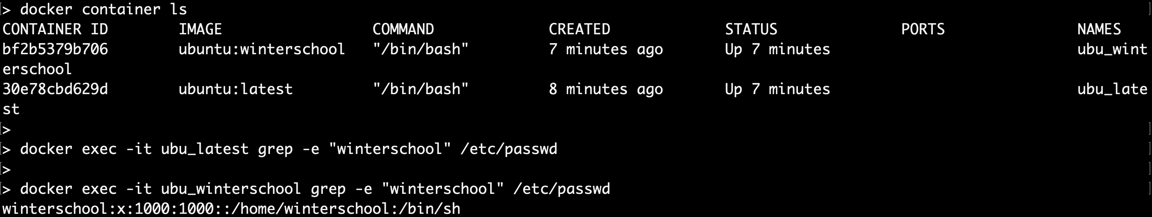
> docker commit
Run ubuntu:latest
Create an user winterschool
Commit the change as a new image ubuntu:winterschool.
Run containers for both images afresh.
Original ubuntu:latest does not have testuser, but ubuntu:testuser has the committed change.

Slide 34
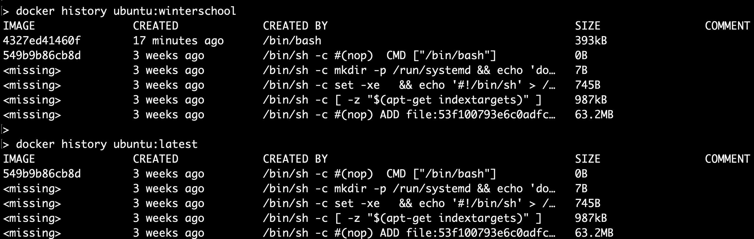
> docker commit
History of the ubuntu:winterschool will show a new layer has been added (marked in red)

Slide 35
Networking Containers

Slide 36
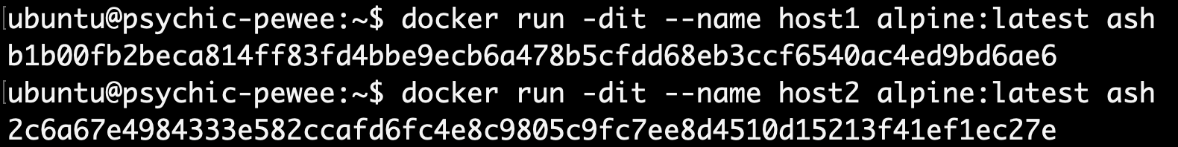
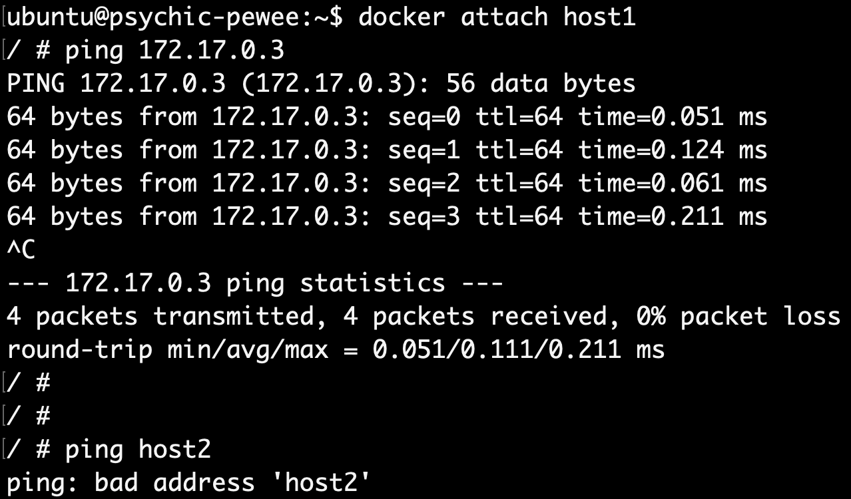
Using Default Network Bridge
Created two alpine-linux containers. Implicitly assigned IP addresses are as follows:
[host1: 172.17.0.2, host2: 172.17.0.3]
Pinging using IP addresses works. But ping fails with container name! This is because default bridge does not support automatic service discovery.

Slide 37
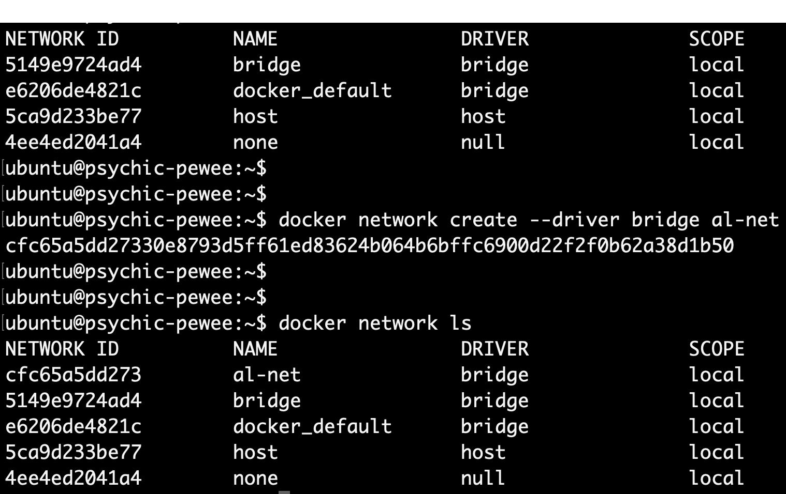
Creating User-Defined Bridge

Slide 38
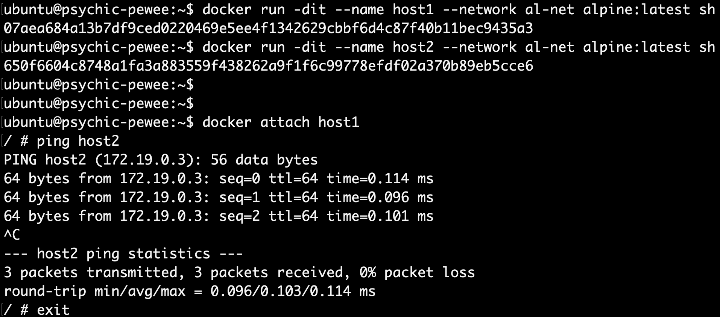
Using User-Defined Network Bridge
Created two alpine-linux containers. Implicitly assigned IP addresses are as follows:
[host1: 172.17.0.2, host2: 172.17.0.3]
Ping using container name works this time because user-defined network bridge supports automatic service discovery.

Slide 39
Docker Compose

Slide 40
Introduction
Docker compose allows the user to configure and run one or more containers as services.
Using docker compose, we could set configurations of the containers, decide on the order of boot-up, volumes to be mounted, networking between containers and more.
We illustrate a very simple use-case of docker-compose in the next slide.

Slide 41
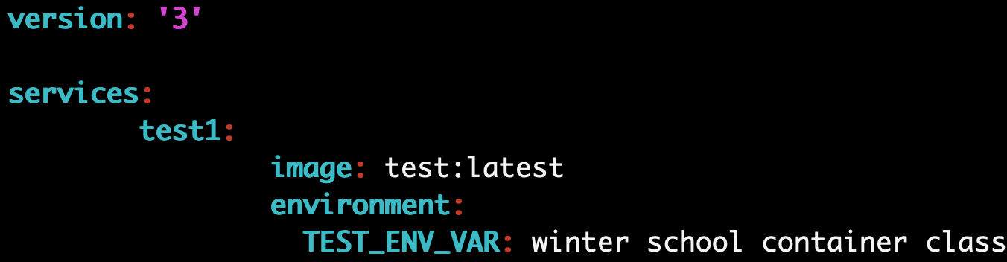
Using docker-compose.yml to Change ENV variable
This docker compose yml modifies the environment variable TEST_ENV_VAR from “This is a winter school demo” to “winter school container class”. The output in the persistence is shown below.

